Slide 1
THE IMPORTANCE OF REGULAR SCHOOL ATTENDANCE
English Learner Advisory Committee

Slide 2
GROUNDING ACTIVITY
ABSENT STUDENT
“Put Yourself in the Picture”

Slide 3
OBJECTIVES
Understand the importance and benefits of regular school attendance
Discuss the reasons students miss school
Understand excused absences, truancy, and the effects of chronic absences
Review ways in which schools and parents can support each other
Make a recommendation to the School Site Council

Slide 4
IT’S THE LAW!
California’s Compulsory Education Law states that it is the responsibility of every parent to assure that every child between the ages of 6-18 attends school every day and on-time. (Ed. Code 48200)

Slide 5
WHY DOES THE LAW EXIST?
Think-Pair-Share

Slide 6
THE IMPORTANCE OF REGULAR SCHOOL ATTENDANCE
Regular and punctual school attendance is one of the most important factors in academic achievement and success.

Slide 7
DISTRICT GOAL
Academic success begins with good attendance!
96-100% in-seat attendance
LAUSD’s Attendance Goal

Slide 8
WHAT IS EXCELLENT ATTENDANCE?
LAUSD’s goal is for ALL students to attend at a rate of 96% or higher.
FAR BELOW BASIC | BELOW BASIC | BASIC | PROFICIENT | ADVANCED
less than 87% | 87-91% | 92-95% | 96-99% | 100%
25 or more absences | 15-24 absences | 8-14 absences | 1-7 absences | 0 absences
 |  |  | More likely to achieve at grade level and graduate
Students with Proficient/Advanced attendance miss no more than 7 days per school year.

Slide 9
SHORT TERM BENEFITS
Students do better in school and are more likely to participate in school activities such as clubs and sports
Students are more likely to have higher self esteem and enhanced confidence in their abilities
STUDENT SUCCESS

Slide 10
LONG TERM BENEFITS
Days Absent per Semester
Source: The Consortium on Chicago School Research at the University of Chicago

Slide 11
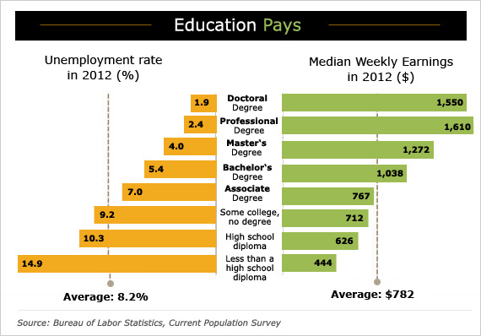
LONG TERM BENEFITS
College Graduation!

Slide 12
OBJECTIVES
Understand the importance and benefits of regular school attendance
Discuss the reasons students miss school
Understand excused absences, truancy, and the effects of chronic absences
Review ways in which schools and parents can support each other
5. Make a recommendation to the School Site Council

Slide 13
Reflection
How is your child doing?
How many days of school did your child miss last year?
Has your child missed any school days this year? If so, how many?

Slide 14
WHY ARE STUDENTS ABSENT?
Think-Pair-Share

Slide 15
WHY ARE STUDENTS ABSENT?
Academic Failure
School Environment
Health Problems
Living Situation
Alcohol and Drug use

Slide 16
WHY ARE STUDENTS MISSING INSTRUCTON?
Academic Failure
Poor grades or frustrations in learning
Low self-esteem, low perceptions of the likelihood of graduating
Adapted From: The Importance of Being in School: A Report on Absenteeism in the Nation’s Public Schools

Slide 17
WHY ARE STUDENTS MISSING INSTRUCTON?
School Environment:
Avoid harassment, bullying, and unsafe situations on the way to and from school
Avoid embarrassment
Students feel that school does not meet their needs, are bored with classes or are not involved in caring relationships
Adapted From: The Importance of Being in School: A Report on Absenteeism in the Nation’s Public Schools

Slide 18
WHY ARE STUDENTS MISSING INSTRUCTON?
Health Problems
annual colds, flu, other childhood illnesses and/or chronic conditions such as anxiety, depression or post-traumatic stress
Adapted From: The Importance of Being in School: A Report on Absenteeism in the Nation’s Public Schools

Slide 19
WHY ARE STUDENTS MISSING INSTRUCTON?
Living Situation:
Housing instability; homelessness, movement between foster care placements, and temporary dislocation
Transportation problems and work-related tasks
High levels of family conflict
For adolescents, family obligations may keep them away from school
Adapted From: The Importance of Being in School: A Report on Absenteeism in the Nation’s Public Schools

Slide 20
WHY ARE STUDENTS MISSING INSTRUCTON?
Alcohol & Drug Use:
Alcohol and drug use can affect judgment or the ability to make choices
It can reduce the ability to remember what is taught in class
It leads to frustration in school and therefore absenteeism
Adapted From: The Importance of Being in School: A Report on Absenteeism in the Nation’s Public Schools

Slide 21
OBJECTIVES
Understand the importance and benefits of regular school attendance
Discuss the reasons students miss school
Understand excused absences, truancy, and the effects of chronic absences
Review ways in which schools and parents can support each other
5. Make a recommendation to the School Site Council

Slide 22
EXCUSED ABSENCES (California E.C. 48205)
dental appointment
court appearance for student
illness or injury
death of an immediate family member
medical appointment
Religious holiday, retreat, or ceremony with prior principal approval
quarantine

Slide 23
EXCUSED ABSENCES
October 9, 2015
Verification for a student’s absence should occur in the form of:
Parent/legal guardian note
Doctor’s note
School nurse
Authorized school personnel designated by the principal
Court paperwork
Dear Mr. Wolfe, I am writing to inform you that Michael was absent from school yesterday because he had oral surgery to remove a tooth. Attached you will find a note from his dentist.
If you have any questions, you may contact me at 555.987-6543.
Sincerely,
Elena Duvon
Siblings, grandparents, cousins, other students cannot provide absence verification.
Elena Duvon

Slide 24
SCENARIOS

Slide 25
SCENARIOS
Your child went home from school with a slight fever yesterday. Throughout the night he was complaining that his body ached. This morning he still has a fever.
Should you send him to school? Why or why not?

Slide 26
SCENARIOS
Your child was sick over the weekend and was not able to finish an important class project. This project counts towards a large percentage of her grade. Your child is crying and begs you to allow her to stay home so that she can finish her project.
Should you allow her to stay home? Why or why not?

Slide 27
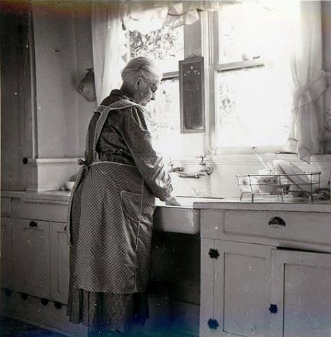
SCENARIOS
Your child has not seen his grandmother in five years. She lives in a different country. This spring, your family will have a chance to take a vacation to visit grandma for a week. Although school will still be in session, it will be after state testing.
Should you take that much deserved vacation? Why or why not?

Slide 28
SCENARIOS
Your child has a physical fitness test today. He knows that he will be asked to do 20 push-ups. During the last physical test he was only able to do 11 and his classmates made fun of him. He felt humiliated. He does not want to feel like that ever again. He assures you that missing the test will not affect his Physical Education grade.
Should you allow him to stay home? Why or why not?

Slide 29
TRUANCY
Students who skip classes are not only breaking the law but most importantly, THEY ARE LIMITING THEIR FUTURE.

Slide 30
TRUANCY
CALIFORNIA EDUCATION CODE SECTION 48260
Definition of Truancy:
An absence from school without a valid excuse, three full days in one school year, or tardy or absent for more than any 30-minute period during the school day without a valid excuse on three occasions in one school year, or any combination thereof.
School districts are mandated to notify a pupil’s parent/guardian upon a pupil’s initial classification as a truant.

Slide 31
CHRONIC ABSENCES
Chronic Absence means missing about 18 school days, regardless of the reason (excused or unexcused).
In the LAUSD, 1 out of every 5 kindergarten and first grade students are chronically absent. Nationally, this number is about half (1 in 10).

Slide 32
CRIMINAL CONSEQUENCES
The Los Angeles County Office of Education identifies truancy as the most powerful predictor of delinquency. Police departments across the nation report that many students not in school during regular hours are committing crimes, including:
auto theft
burglary
vandalism
shoplifting
serious assault
Adapted from Parents’ Guide to Truancy.

Slide 33
EDUCATIONAL CONSEQUENCES
Students who are absent for any period of time will miss core instruction and will fall behind their peers in the classroom
Chronic absence in any grade puts students at-risk for failing grades
Struggling in school leads to low self-esteem and increases the likelihood that students will drop out of school
- 82% of prisoners are dropouts.

Slide 34
LIFELONG CONSEQUENCES
Truancy has been identified as a strong predictor of low educational attainment, lower wages, higher unemployment and, in general, lower quality of life.
Adapted from the National Center for School Engagement – Promoting attendance, attachment and achievement

Slide 35
LIFELONG CONSEQUENCES
Social isolation
Low self-esteem
Feelings of rejection
Imprisonment
Drug addictions
High School drop-out
Limited career opportunities
Adapted from the National Center for School Engagement – Promoting attendance, attachment and achievement

Slide 36
WHAT DO YOU WANT FOR YOUR CHILD?

Slide 37
OBJECTIVES
Understand the importance and benefits of regular school attendance
Discuss the reasons students miss school
Understand excused absences, truancy, and the effects of chronic absences
Review ways in which schools and parents can support each other
5. Make a recommendation to the School Site Council

Slide 38
WHAT PARENTS CAN DO
Make sure your child gets enough sleep and a nutritious breakfast each day
Help your child develop a positive attitude toward school and learning and encourage him/her to participate in school activities
Teach the benefits of good attendance and consequences of poor attendance
REF-5464.2 - School Attendance: A Guide for Parents

Slide 39
WHAT PARENTS CAN DO
Create a back-up system or alternate plans for getting to and from school.
Create morning and evening routines.
Post school calendars, and schedules in a visible place.
Make your school aware of any issues that may be affecting your child’s attendance.
Encourage good attendance and being on time.
REF-5464.2 - School Attendance: A Guide for Parents

Slide 40
WHAT PARENTS CAN DO
Plan family vacations for non-school days only
Use LAUSD’s Parent Access Support System portal (PASSport) to track your child’s attendance
Schedule non-emergency medical and dental appointments after school hours on weekends or during your child’s vacation
If the appointment must be during school hours, please have your child attend school prior to the appointment and/or return to school after the appointment to complete the school day
REF-5464.2 - School Attendance: A Guide for Parents

Slide 41
WHAT PARENTS CAN DO
Make sure your child’s school has your accurate daytime contact information
Notify school staff if your child suffers from a chronic health condition and how this condition is impacting school attendance
Communicate often with your child’s teachers and request assignments missed during absences
REF-5464.2 - School Attendance: A Guide for Parents

Slide 42
WHAT PARENTS CAN DO
Parents make the difference!

Slide 43
WHAT ELAC CAN DO
Monitor attendance data and make recommendations to School Site Council that support the creation of concrete and measurable goals and services for attendance improvement
Encourage School Site Council and principal to:
Invite other parents to get involved by attending meetings, workshops, and parent-teacher conferences and other school events
Set up a parent network for parents to share concerns, strategies and ideas

Slide 44
OBJECTIVES
Understand the importance and benefits of regular school attendance
Discuss the reasons students miss school
Understand excused absences, truancy, and the effects of chronic absences
Review ways in which schools and parents can support each other
5. Make a recommendation to the School Site Council

Slide 45
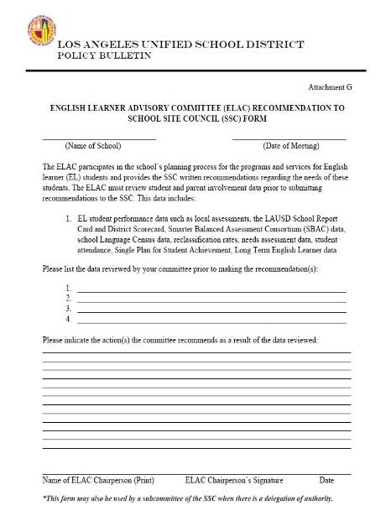
THE RECOMMENDATION PROCESS
Wonderful High School
October 23, 2016
School Report Card Data
Attendance Data
Long Term English Learner Data
Mandated Topic: The Importance of Regular School Attendance
\
The ELAC recommends an attendance incentive program that will motivate students to attend school daily and on time. The primary target should be 5th grade since it shows the lowest attendance percentage for ELs. Data shows that poor attendance might be a contributing factor to the large number of LTELs found in this grade level. The incentives might include honorary mentions by the principal, during school assemblies and over the PA system. Incentives should also include certificates for parents whose children attend daily and on time.
Ray Ruiz
10/23/16

Slide 46
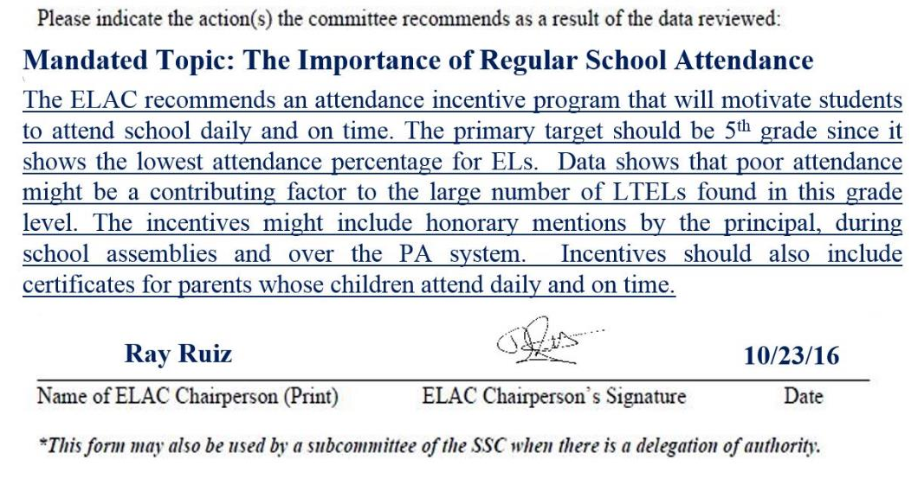
THE RECOMMENDATION PROCESS

Slide 47
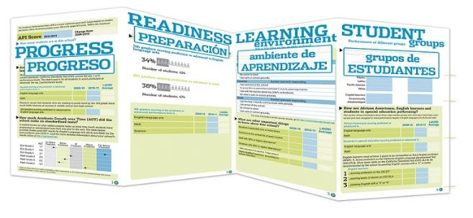
Handout #1
HOW IS OUR SCHOOL DOING?

Slide 48
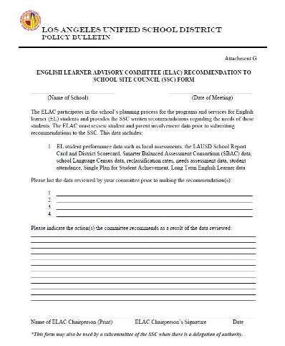
THE RECOMMENDATION PROCESS
Handout #2
PROCESSING ACTIVITY:
Let’s make a recommendation!

Slide 49
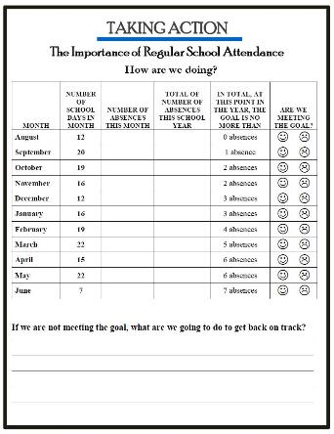
TAKING ACTION
Handout #3

Slide 50
OBJECTIVES
√
Understand the importance and benefits of regular school attendance
Discuss the reasons students miss school
Understand excused absences, truancy, and the effects of chronic absences
Review ways in which schools and parents can support each other
5. Make a recommendation to the School Site Council
√
√
√
√

Slide 51
REFLECTION
3-2-1
On a piece of paper:
Write 3 new ideas you learned today.
Write 2 ways you will support your student.
Write 1 action step you will take.

Slide 52
COMMENTS/QUESTIONS?

